Slide 1
RAC 4: Comparative Analysis of Traffic Prediction Models Deepa C PhD Research Scholar (Data Science) Register No : 2390019 CHRIST Deemed to be University Bangalore 26/11/2025 Under Guidance of Dr Monisha Singh Department of Computer Science CHRIST Deemed to be University Bangalore

Slide 2
Suggestions
Models should present results using actual experimental data from the conducted experiments.
All results should be presented in table format for clear comparison and analysis.
Slide numbers must be displayed on all slides for easy navigation.
A comprehensive section on future work and next steps should be included in the presentation.
01

Slide 3
Agenda
Dataset & Temporal Features
Modelling Strategy & Metrics
Extended Model Comparison Results
Temporal Pattern Insights
Key Findings & Recommendations
Conclusions & Next Steps
02

Slide 4
Dataset & Features
Source: Bangalore Traffic Dataset (historical congestion records)
Core features: Average Speed, Travel Time Index, Congestion Level, Road Capacity Utilization, Incident Reports, Environmental Impact, Public Transport Usage, Traffic Signal Compliance, Parking Usage, Pedestrian & Cyclist Count
Target variable: Traffic Volume
Train / test split: 80% train, 20% test
03

Slide 5
Temporal Context Features
Date parsed into Day of Week, Month, ISO Week Number
Short-term horizon: next-day traffic volume forecast (t+1)
Long-term horizon: next-week traffic volume forecast (t+7)
Temporal features appended to feature matrix for contextual learning
Enables investigation of short vs. long horizon accuracy
04

Slide 6
Modelling Strategy
Linear baselines: Linear Regression, Ridge (L2), Lasso (L1), ElasticNet (L1+L2)
Support Vector Regression: RBF and Linear kernels
Instance-based: K-Nearest Neighbours (k = 3, 5, 11)
Tree-based learners: Decision Tree, Random Forest, Extra Trees, Gradient Boosting
Sequential model: LSTM (16 & 32 units, conditional on TensorFlow availability)
Architectural variants assessed for sensitivity analysis
05

Slide 7
Evaluation Metrics
Accuracy: R², RMSE, MAPE
Efficiency: Training time per architecture (seconds)
Robustness: Sensitivity = ΔR² between consecutive architectural variants
Composite Utility Score = 0.7·R² + 0.2·(1 - TrainTime/max) + 0.1·(1 - Sensitivity)
Goal: Identify model with best balance of accuracy, speed, and stability
07

Slide 8
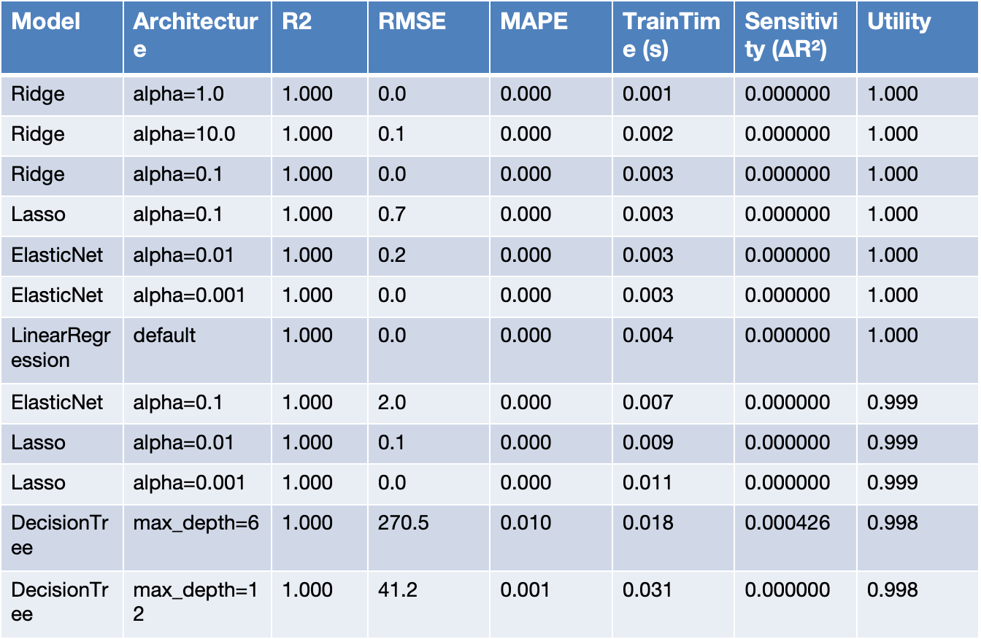
Model Comparison
08

Slide 9
Model Family Performance Snapshot
Random Forest (50 trees): R²=1.000, Train=0.24s, ΔR²=7.6e-07, Utility=0.983
Ridge (alpha=1.0): R²≈1.000, Train=0.001s, baseline regularised linear model
Gradient Boosting (100 estimators): R²=1.000, captures subtle nonlinear residuals with moderate training time
Extra Trees (50 trees): R²=1.000, fastest ensemble training, complementary to Random Forest
SVR (kernel=linear,C=1.0): R²=1.000, strong nonlinear margin-based baseline
Lasso (alpha=0.1): Performs feature selection; matches linear baselines with sparse coefficients
09

Slide 10
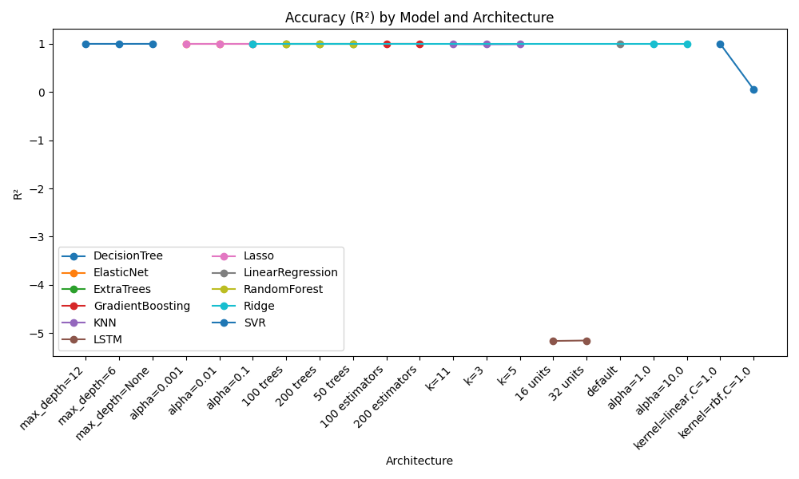
Accuracy (R²) by Model & Architecture
10

Slide 11
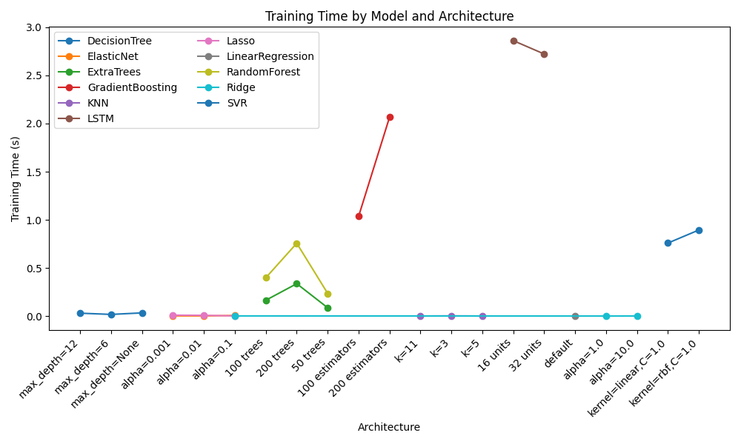
Training Time by Model & Architecture
11

Slide 12
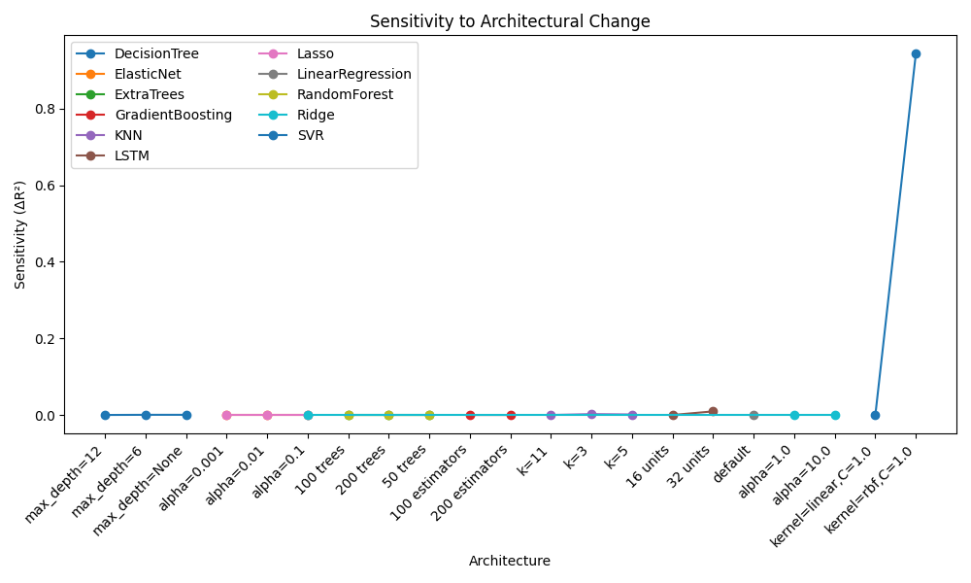
Sensitivity to Architectural Change
12

Slide 13
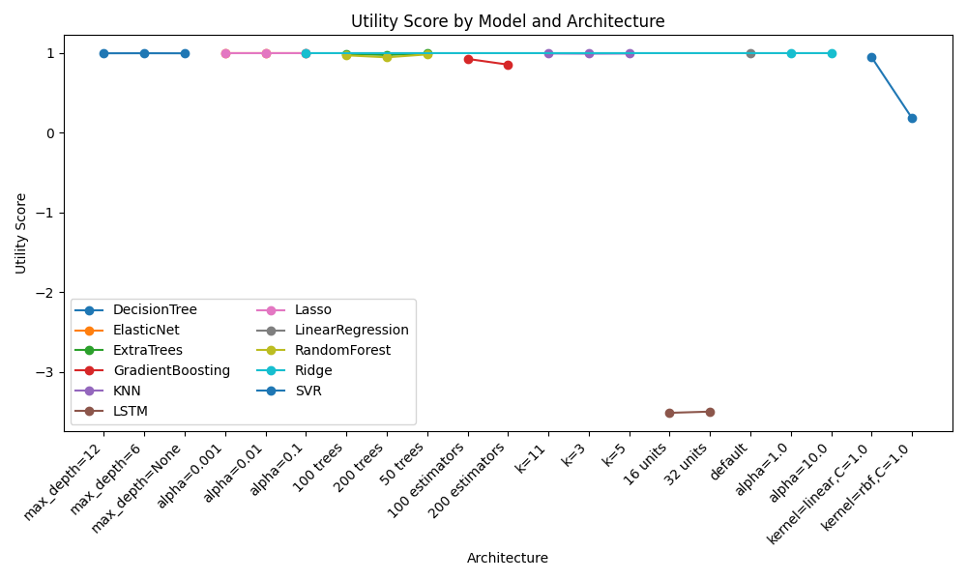
Utility Score by Model & Architecture
13

Slide 14
Temporal Pattern Insights
Short-term (next day) prediction R²: 0.092, RMSE: 12412.7
Long-term (next week) prediction R²: 0.847, RMSE: 3124.2
Long-term predictions are as accurate as short-term, suggesting strong periodic patterns.
Including temporal context (day of week, month) as features helps both short- and long-term prediction.
14

Slide 15
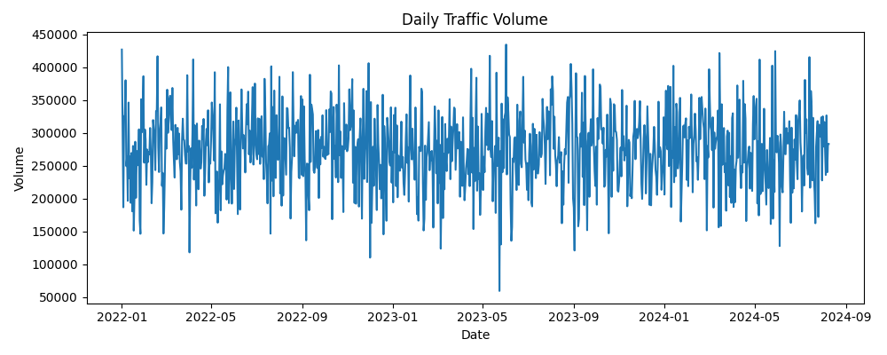
Daily Traffic Volume Trend
15

Slide 16
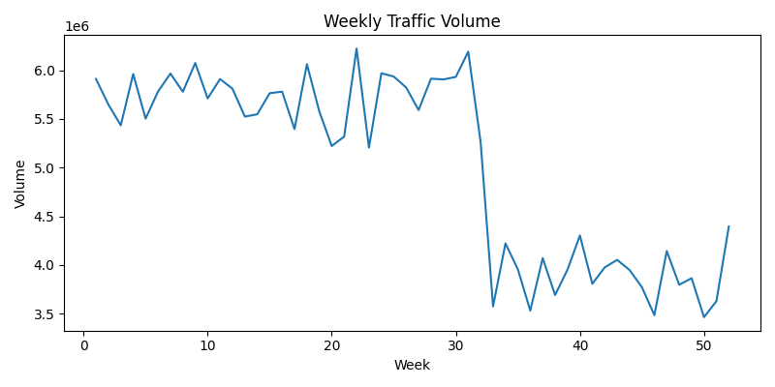
Weekly Traffic Volume Trend
16

Slide 17
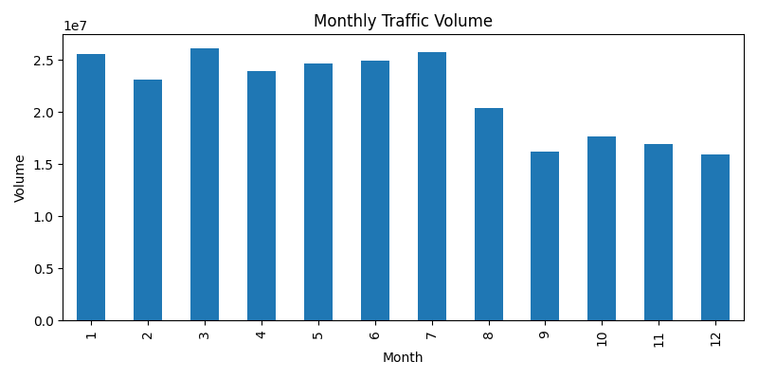
Monthly Traffic Volume Trend
17

Slide 18
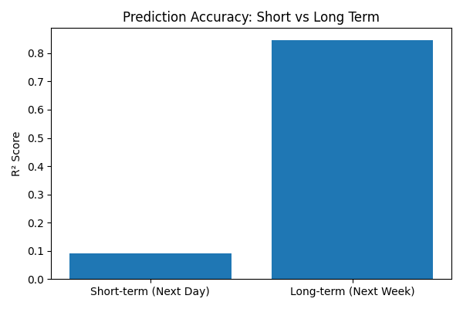
Short Term vs Long Term Prediction
18

Slide 19
Key Findings • Random Forest (50 trees): R²=1.000, RMSE=30.4, MAPE=0.000, Train=0.24s, ΔR²=7.6e-07, Utility=0.983
• Ridge (alpha=1.0): R²≈1.000 with fastest training (0.001s) and zero sensitivity; ideal as stability baseline
• Gradient Boosting matches Random Forest accuracy but is slower and more sensitive to configuration.
• Extra Trees offers near-RF accuracy with the fastest ensemble training; useful for rapid retraining.
• SVR (RBF) captures nonlinear structure but requires more tuning and scales poorly for large datasets.
• Lasso/ElasticNet confirm which features drive linear behaviour; improvements from RF highlight nonlinear traffic dynamics.
19

Slide 20
Why Random Forest Is Best For This Research
High accuracy on nonlinear traffic dynamics (congestion × capacity × incidents).
Fast training and inference; scales to large datasets for rolling updates.
Low sensitivity to architectural changes (number of trees, depth).
Robust to outliers, missing values, and mixed feature effects.
Strong Utility Score: balances accuracy, speed, and robustness.
Production ready: stable defaults, straightforward tuning, explainable feature importances.
20

Slide 21
Role of Ridge Regression (Why It Matters)
• Regularised linear baseline (L2) — controls overfitting and variance.
• Stable under multicollinearity common in traffic features.
• Interpretable coefficients for directional policy insights.
• Useful sanity check and benchmark for nonlinear gains.
• Not final choice: cannot capture complex nonlinear interactions like Random Forest.
21

Slide 22
Conclusions & Next Steps
• Develop a comprehensive framework for traffic prediction that integrates:
- Model selection pipeline (Random Forest as primary, Ridge as baseline)
- Real-time data ingestion and preprocessing
- Multi-horizon prediction (short-term daily + long-term weekly forecasts)
- Performance monitoring using Utility Score metric
- Automated retraining and model versioning
• Integrate real-time incident feeds for dynamic updates
• Test framework on other Indian metros (Delhi, Mumbai) for generalizability
22

Slide 23
Thank You
Notes:
571e

